Slide 1

Brain Tumor Classification using deep learning with parametric optimization
Minor Project Presentation
\

Slide 2
Lakhanji Mishra 2001072
Rajat Pandey 2001050 Manish Kr. Maurya 2001090
Deepak Kumar 2001075 --Under The Supervision of :- Dr. Prakash Ranjan Assistance Professor, ECE Department, IIIT Bhagalpur
Presented By:

Slide 3
CONTENTS
Introduction
Aim and Motivation
Model Training
Results
Conclusion
Requirments
Optimizers
Data acquisition & pre-processing
segmentation

Slide 4
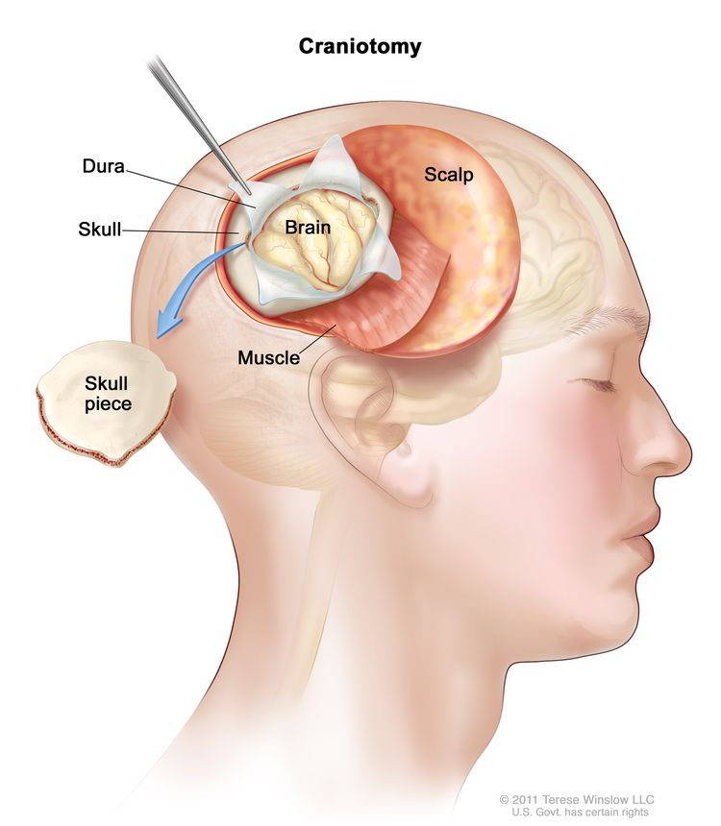
Introduction
A brain tumor is the growth of abnormal cells in the brain.
Types of Brain Tumours:-
Meningiomas Tumour: It start from the membranes that surrounds the brain and surrounds the central nervous system.
Pituitary Tumour: these are lumps that are inside the skull.
Gliomas Tumour: It arise from brain tissues other than nerve cells and blood vessels.
How to Detect Brain Tumor?
Magnetic Reasoning Imaging (MRI)
Brain Tumour Classification Using CAD (Machin learning And Deep Learning)..
Why Deep learning and Machine learning?
DP is used to create models for detecting and categorizing brain tumors using MRI.
ML is used to Train and Test the model.

Slide 5
Introduction Cont...
Model?
EfficientNetB7 model is used Improving Accuracy and Efficiency .
Optimizers:-
1. SGD
2. RMSprop
3. Adam
4. Adagrad
5. Adadelta.

Slide 6


Requirments:-
Google Colab
Python
Tensorflow
Keras
matplotlib
Streamlit
Motivation And Objective:-
Early Detection for Improved Outcomes
Complexity of Brain Tumor Patterns
Reduction of Diagnostic Time
Enhanced Accuracy and Precision
Utilization of Large Medical Datasets.
Evaluate Model Performance

Slide 7
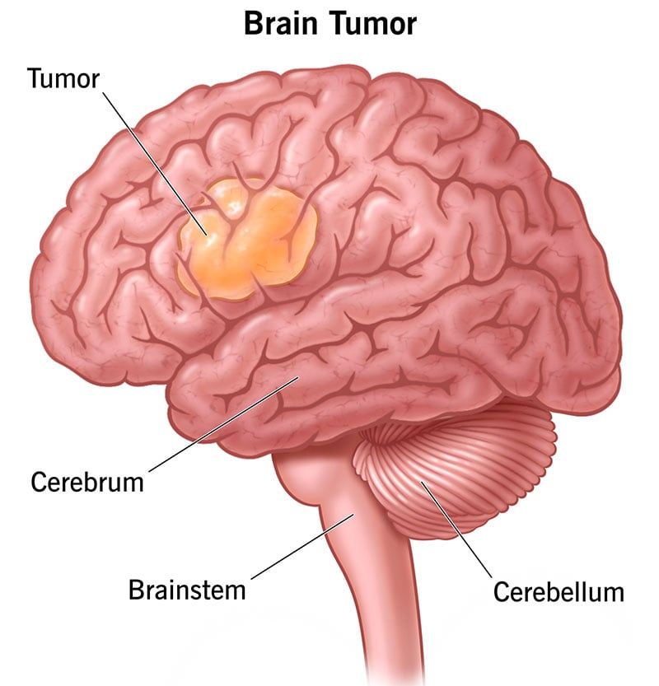
The Challenges In Brain Tumor Classification
Variations in Tumor Characteristics: Brain tumors vary greatly in location, shape, and size This variability makes it difficult to develop a universal model for detection and classification.
Complexity of Brain Structure: The complexity and high-density nature of the brain add to the difficulty of classifying brain tumors.
Quality and Type of Scans: It’s hard to fully segment and classify brain tumors from mono-modality scans because of the complicated structure of the brain.
Rapid Growth: The size of a brain tumor grows rapidly. Therefore, tumor diagnosis at an initial stage is an exigent task

Slide 8
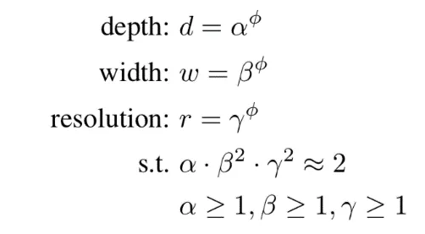
Model Training
EfficientNetB7:-
It is a CNN architecture and scaling method that uniformly scales all dimensions of depth/width/resolution using a compound coefficient.
The EfficientNet scaling method uniformly scales network width, depth, and resolution with a set of fixed scaling coefficients
Compound scaling:
It uses a compound co-efficient ø to scale width, depth, and resolution together. Below is the formula for scaled attributes:

Slide 9
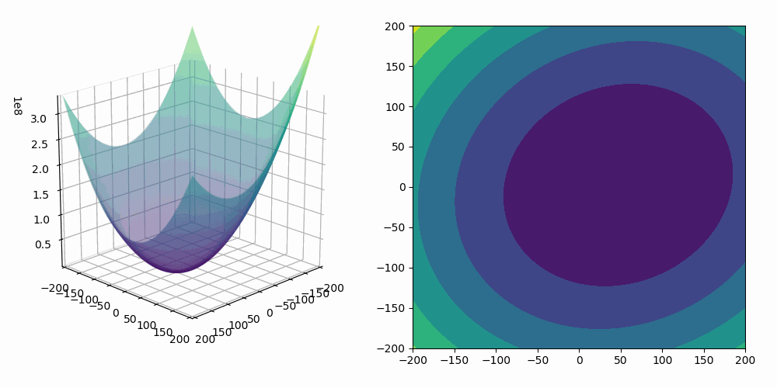
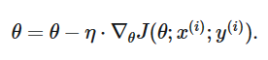
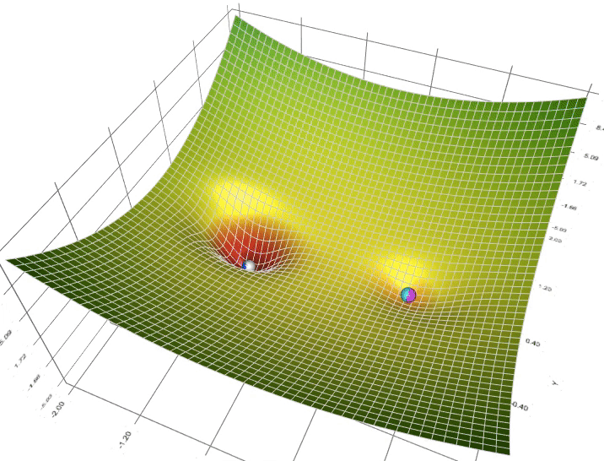
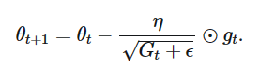
Optimizers:
SGD:-
Stochastic gradient descent (SGD) in contrast performs a
parameter update for each training example x(i) and label y(i):
SGD does away with this redundancy by performing one
update at a time.
Adagrad:-
It adapts the learning rate to the parameters, performing smaller updates for parameters associated with frequently occurring features, and larger updates for parameters associated with infrequent features.

Slide 10
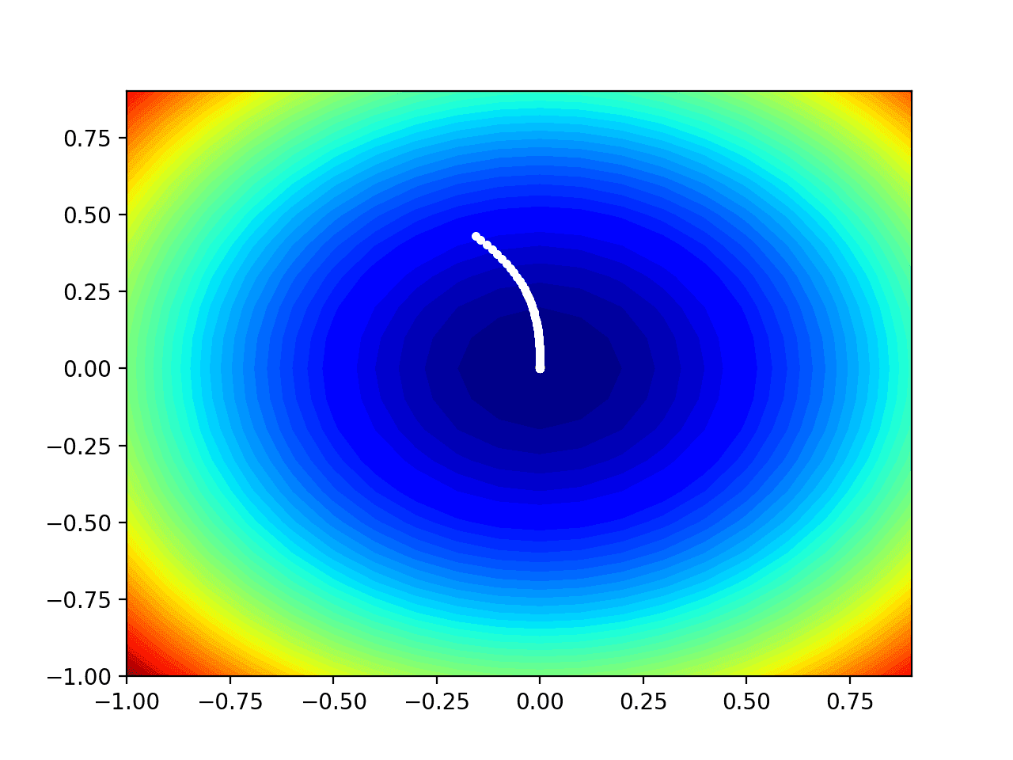
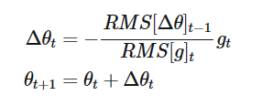

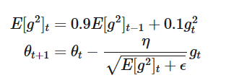
Adadelta:-
Adadelta is an extension of Adagrad that seeks to reduce its aggressive, monotonically decreasing learning rate. Instead of accumulating all past squared gradients, Adadelta restricts the window of accumulated past gradients to some fixed size w.
RMSprop:-
RMSprop and Adadelta have both been developed
independently around the same time stemming
from the need to resolve Adagrad's radically diminishing
learning rates.

Slide 11
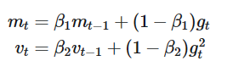

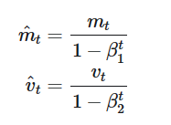
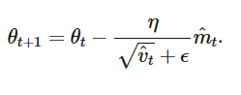
Adam:-
Adaptive Moment Estimation (Adam) ^{[14]} is another method that computes adaptive learning rates for each parameter. In addition to storing an exponentially decaying average of past squared gradients vt. like Adadelta and RMSprop, Adam also keeps an exponentially decaying average of past gradients mt, similar to momentum
values of 0.9 for β1, 0.999 for β2, and 10^-8 for ϵ

Slide 12
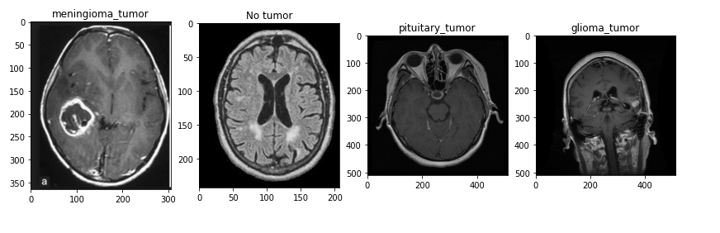
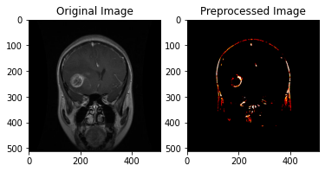
Data acquisition & pre-processing
Image Database:
The dataset for this study was obtained from Kaggle and
is therefore publicly availableThe dataset consists of
2 227 training MRIs and 429test MRIs. There are 826
glioma tumour, 247 meningioma tumour, 827 pituitary
tumour and 327 no tumour MRIs in the train dataset.
The test dataset consists of 98 pituitary, 100 glioma, 127 meningioma, and 104 no tumour MRIs.
Image Pre-Processing:
The MRIs came in different sizes and were therefore resized to suit the different models. The MRIs were also normalized. Normalization is important to ensures that each pixel has a similar data distribution to the other pixels. Normalization makes the network converge fast. The below figure shows a sample of a pre-processed image.

Slide 13
Data training and fine tunning
The models used for the project were originally trained with the ImageNet dataset that is comprised of 1.2 million images that belong to 1000 categories.Tumor classification was done using transfer learning with EfficientNetB7. Transfer learning is a machine learning method that reuses a model trained on one task on another related task.EfficientNet put forward a method called compound scaling. Compound scaling is a constant ratio to scale the network in all dimensions(width, resolution and depth). Compound scaling also solves the problem of the extent to which the network should be scaled therefore increasing accuracy of the network and also decreasing the need for manual tuning.
Fine Tunning
For this phase we tuned the following hyperparameters of the models, batch size, epochs, optimization method, and dropout values. For optimizers, we used only 5 optimizers to see which one works best, namely, SGD, RMSprop, Adam, Adagrad, and Adadelta. For number of epochs, we used only 4 epochs to choose the best performer from namely, 1, 2, 5, 10. With Batch size we used these batch sizes to choose the optimum batch size, namely, 8 and 16. For dropout value we used the following values to optimise the dropout of the model, values 0.5, 0.6, 0.7, 0.8, and 0.9.
Segmentation
The quality of the images is first enhanced by brightening the image. Then we use contrast enhancing to enhance local contrast of the brain MRI to help brighten the area with the tumor. Then the image was changed to a grayscale image. MRI images often have noise because of the equipment used to collect the images, so the noise was removed. Then thresholding is used to segment the part of the tumor.

Slide 14
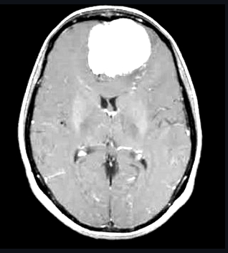
Segmentation cont..
The thresholding makes the parts of the image that have pixel values that are above the threshold white while the parts of the image that have pixel values less than the threshold black. The area with the tumor will be the white region as the tumor is brighter than normal parts of the brain.
Results Analysis of model:-
Fine-tuning of hyperparameters was done to see which hyper-parameters give the best results. The optimum parameters were then used to train the model. The model was trained using 5 different optimizers, 4 different epochs, 2 batch sizes and 5 dropouts. The time it took to train the model was retrieved. The model was first fitted using 4 epochs, a batch size of 8 and a dropout value of 0.5 and the optimizer used was the Adam optimizer. The model gave an accuracy of 95% and ran for 95 minutes

Slide 15
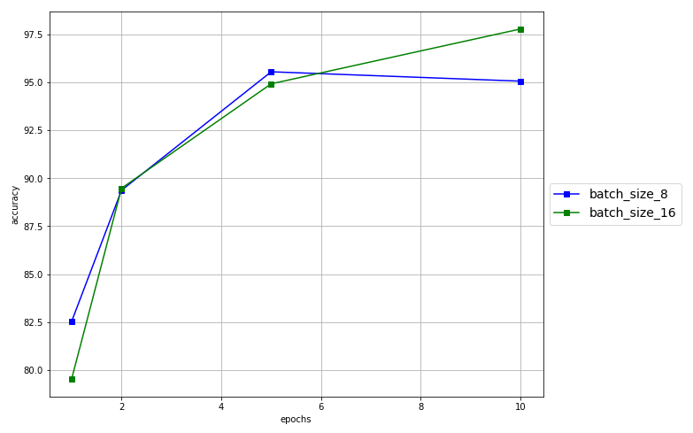
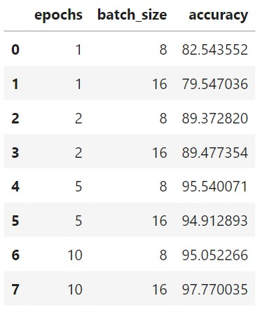
Model development and fine-tuning EfficientNetB7 - Batch size and Epochs
Batch size and epochs were fine tuned at the same time. The below table shows the results for the 2 batch sizes and 4 epochs.The highest accuracy was obtained from using 10 epochs and a batch size of 16

Slide 16
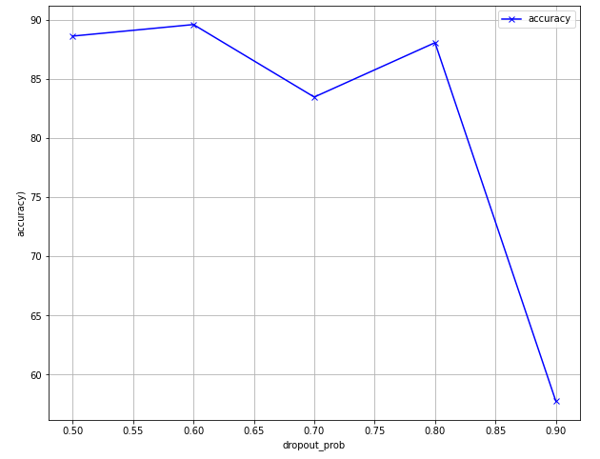
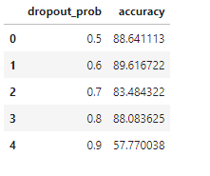
EfficientNetB7 – Dropout:
Dropout values were fine-tuned, it shows the accuracy of each dropout value while the other hyper-parameters remained the same.
The dropout value 0.6 got the highest accuracy while the dropout value of 0.9 got the lowest accuracy.

Slide 17
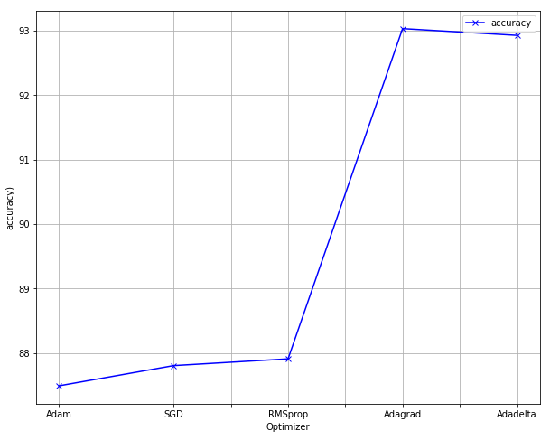
EfficientNetB7 – Optimizer:-
It was fitted with the different optimizers with 4 epochs for each one and a dropout value of 0.5.The figure shows that Adagrad is the optimizer that got the highest accuracy of 93% and Adam got the lowest accuracy
Sr_no. | optimizer | accuracy
0 | Adam | 83.5675
1 | SGD | 86.2371
2 | RMDprop | 87.8745
3 | Adagrad | 94.1432
4 | Adadelta | 92.9845

Slide 18
Results
Transfer learning is one of the proven techniques for computer vision tasks like the classification of images. This study considered two pre-trained models namely VGG-16 and EfficientNetB7. The models were also trained with fine-tuned hyper-parameters namely batch size, epochs, and optimizers. The models were run with 5 different optimizers, 4 different epochs, and 2 different batch sizes. But they are all first fitted with 4 epochs, with optimizer Adam, batch size of 8 and a dropout value of 0.5.
The results for fine tuning optimizers for VGG-16 and Efficient Net are shown in the table below. The Vgg-16 model obtains an accuracy of 92%, and the EfficientNetB7 gets the highest accuracy of 95%. The results for the optimizers that gave the highest accuracy for each model are given in the table below.
EfficientNetB7 has a total of 66 million trainable parameters
optimizer | 93.03%
Batch size | 16
epoch | 10
droupout | 0.6
Valitading accuracy | 98.03%
Trining accuracy | 93.06%
Trainable parameter | 66M

Slide 19
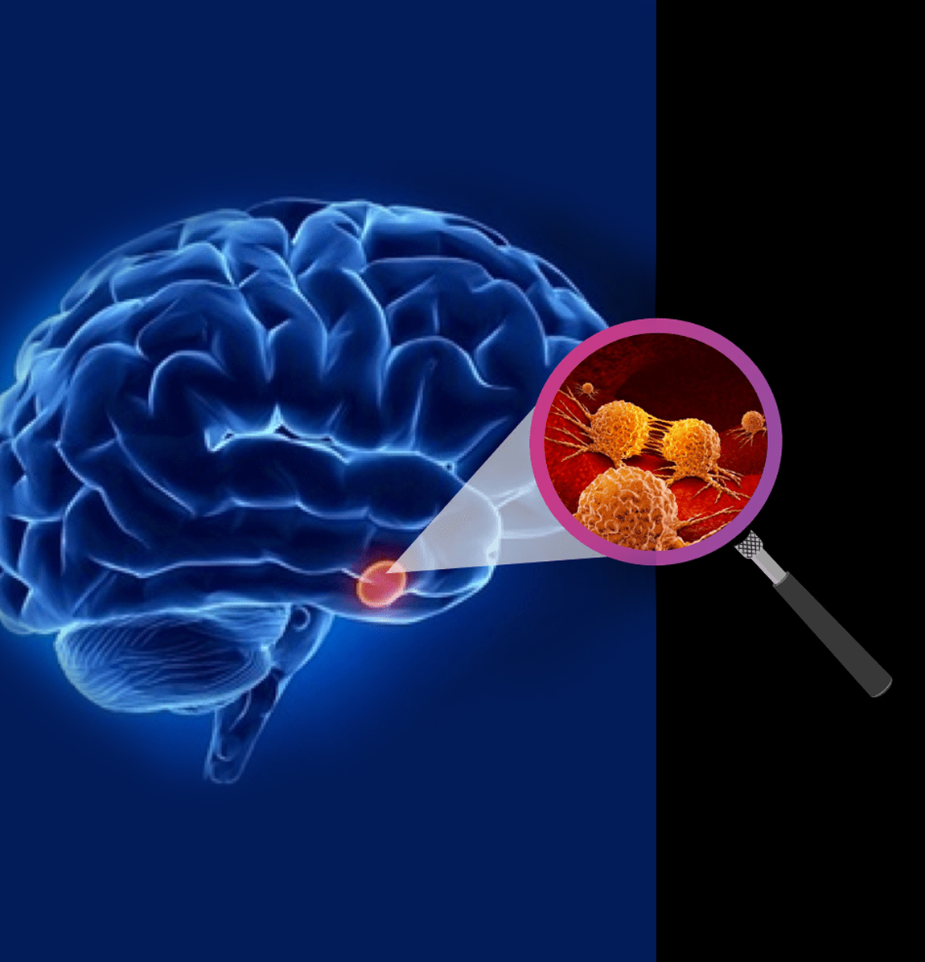
Conclusion:
This minor project is a pre-trained deep convolutional neural network namely, EfficientNetB7 and compared its complexity and performance on classification of brain tumor MRI images suing different optimizers, In our project we used 6169 MRI images. The goal was to find the more suitable optimiser for our task. all optimizers were able to classify the tumors as glioma tumor, meningioma tumor, pituitary tumor and no tumor. EfficientNetB7 achieved 98.18% classification accuracy using transfer learning. This project also shows the effectiveness of fine-tunning on performance.

Slide 20
Future work
Experiment with Different Models: While we used a specific architecture for this project, other architectures could potentially yield better results.
Use More Data: The performance of deep learning models generally improves with more data. Collecting more brain MRI images could improve our model’s performance.
Try Different Preprocessing Techniques: Different ways of preprocessing the images might yield better results.
Hyperparameter Tuning: Tuning the hyperparameters of our model could lead to better performance.

Slide 21

Thank You!

